Slide 1

Study Module Piloting
Riga Technical University (HEI) Experience
Course Battery Technology & Systems (THWS)
Ph. D. Arturs Bogdanovs
Senior researcher, lecturer
25.03.2026.

Slide 2
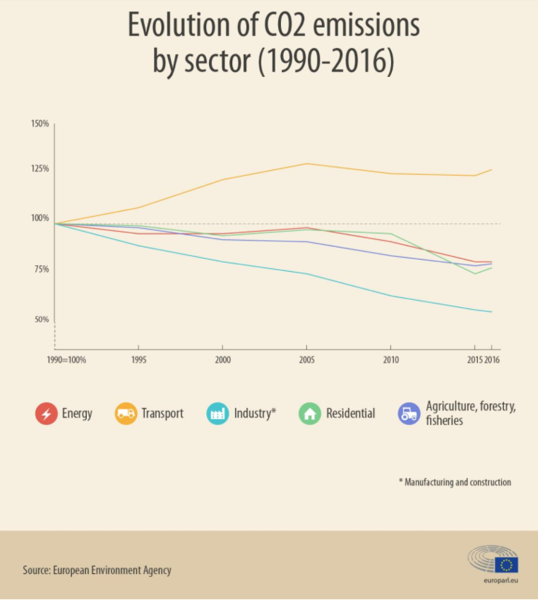
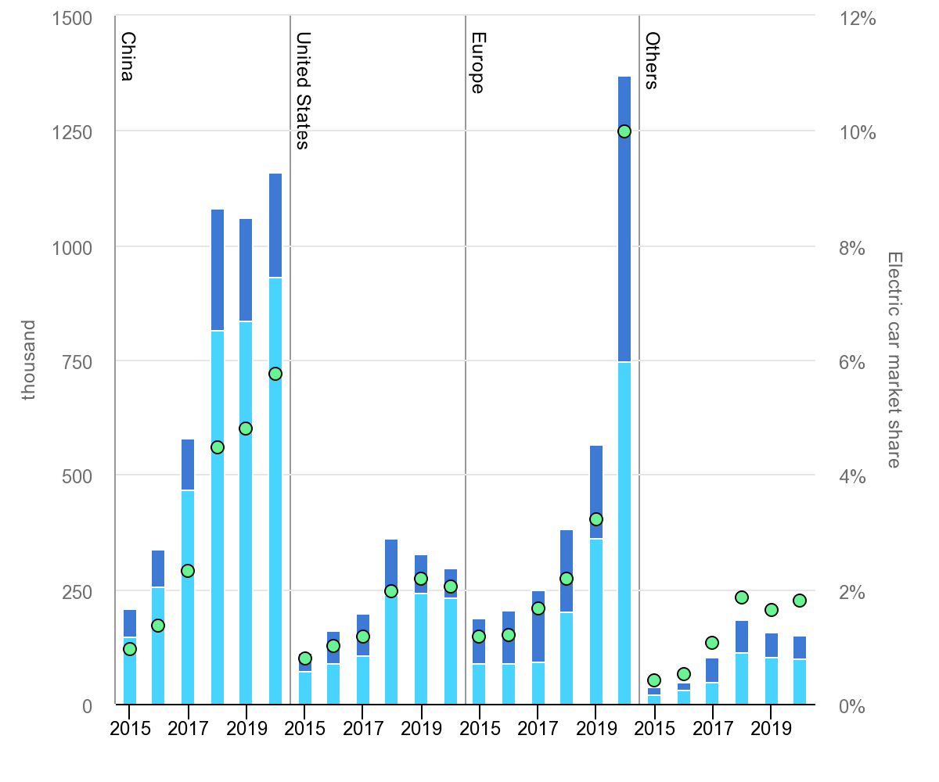
1. Introduction: Climate change, e-mobility & education
Climate change, e-mobility & engineering education – how are they related:
  Climate change is one of the greatest challenges nowadays;
  E-mobility - effective solution to emission reduction problem in transport;
  Education system must be adjusted and developed according to modern trends already now;
Practically oriented e-mobility
related courses are required!

Slide 3
1. Introduction: Required skills and methods
Essential skills and competences:
  competence of working with hazardous voltage levels;
  practical skills in electrical measurements;
  knowledge about safety features to reduce occupational risks;
  ability to design an electrical drive system;
  knowledge about control systems and ICT trends;
  in-depth knowledge of power electronics systems.
Modern didactical methods:
  transdisciplinary teaching approach;
  problem-based project-oriented learning;
  cooperative learning methods and inquiry-based classes;
  case studies and practical assignments;
  animations and simulations;
  encouraging laboratory classes.

Slide 4
2. Previous experience with e-mobility
Boundary conditions – previous student knowledge:
  Mechanical engineering background;
  Physics (12 ECTS);
  Electrical Engineering and Electronics (6 ECTS);
  Automotive Electrical and Electronic Systems (4.5 ECTS).
Contents are split into 2 courses (3 ECTS each):
  Introductory course Electrical Road Vehicle Technology:
    interdisciplinary approach and problem-oriented learning strategy;
    cooperative learning method by defining the group work task on EV drivetrain simplified design;
  Advanced course Innovative Automotive Technology:
    focused on the individual assignments;
    modeling, simulation and case study tasks;
    laboratory works
650 V class commercially available SiC/GaN

Slide 5
2. Previous experience:
Electrical Road Vehicle Technology
Goal - to introduce students with electrified drivetrain vehicle types, main components, their design and technical condition monitoring on the principal, detailed and functional integrity levels;
Contents:
  repetition of basic electrical engineering,
  guidelines of e-mobility,
  electric drive scheme types and components:
    electric machines,
    power electronics converters,
    energy storage technologies.
Course contents and workload
Course contents | Contact hours | Individual workload (hours)
A brief history and introduction to electric vehicles. | 2 | 1
Seminar about the electric vehicle types. | 2 | 3
Electric vehicle architectures and main components. | 2 | 1
Electric vehicle transmission. Main gear. Planetary gear. | 2 | 1
Introduction to electric machines. | 2 | 1
AC machines, their types, design and operation. | 2 | 1
Electric machine review. Electric machine manufacturing and maintenance. | 2 | 1
Energy storing technologies. | 2 | 1
Automotive battery technology. Li ion batteries. Battery management. | 2 | 1
Electric machine and battery calculation methods. Homework assignment. | 2 | 5
Introduction to power electronics. Converter topology analysis methods. | 2 | 1
DC converter. Converter loss and efficiency estimation methods. | 2 | 1
Converter for electric machine. Inverter. Motor controller. | 2 | 1
Electric vehicle charging technologies. | 2 | 1
Charging devices. Charger and external battery management converter topologies. | 2 | 1
Electric vehicle service and operation. Technical condition monitoring methods. | 2 | 1
Group project development and presentation. | 2 | 12
Course review discussion. | 2 | 0
Consultations. Question and answer session. | 2 | 0
Exam | 2 | 6

Slide 6
2. Previous experience: Innovative Automotive Technology
Goal – to introduce students with the research findings and innovations, resulting in the modern electric and autonomous vehicle technologies;
Contents:
  review on new electric machine types
  modeling of power electronics,
  basics of modern variable frequency drives
  battery management systems,
  advanced automotive auxiliary control systems,
  fundamentals of signal processing and control engineering
Course contents and workload
Course contents | Contact hours | Individual workload (hours)
Introduction to DC and AC machines. Computerized simulation methods. | 2 | 1
Rotating magnetic field. Space vector definition. Clarke and Park transform. Asynchronous drives. | 2 | 1
Synchronous drives. Automotive application examples. | 2 | 1
Prospective electric machine types, comparative analysis of electric machine types. Homework assignment no. 1. | 2 | 5
Repetition of power electronics basics. Converter topology analysis methods. | 2 | 1
Inverter. Space vector modulation. Basics of electric machine control. | 2 | 1
Automotive power electronics application. Advanced vehicular energy net. Recent advances in power electronics. | 2 | 1
Power sources and energy storage. Lithium ion batteries. Battery management systems. | 2 | 1
Introduction to driver assistance systems. Sensor technology. Signal processing. | 2 | 1
Artificial intelligence application in driver assistance systems and autonomous vehicles. | 2 | 1
Seminar about driver assistance system and autonomous vehicle technologies. | 2 | 4
Practical work. Acquisition and analysis of DC buck converter characteristics, using simulation methods, reporting | 2 | 2
Practical work. Computerized inverter design assignment, reporting | 2 | 2
Practical work. Solenoid valve turn-on parameter setup, using simulation methods, reporting | 2 | 2
Practical work. Automotive Li-ion battery pack design analysis and determination of electric characteristics, reporting | 2 | 2
Practical work. Automotive inverter design analysis, determination of electric characteristics, reporting | 2 | 2
Practical work. Problems on power electronics topology analysis. Homework assignment no. 2 | 2 | 5
Practical work. Automotive power electronics problems and ways to find solutions | 2 | 1
Consultations. Question and answer session. | 2 | 0
Exam | 2 | 6

Slide 7
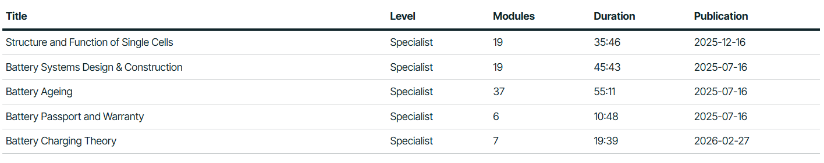
3. Study Module Piloting Setup
Battery Technology & Systems (THWS) :
Timeframe: January –March 2026 (Spring semester)
Integrated into Electrical Road Vehicle Technology Course (HW assignment)
Piloting group details:
  3rd year undergraduate students of Automotive Engineering at Riga Technical university
  20 out of 32 students took part in piloting the course modules
  6 most active students finished >50 modules (1 student finished all 88 modules)

Slide 8
4. Results: Overall Impression
The piloted module is perceived as relevant and aligned with modern engineering education
Students recognize the importance of battery technologies and e-mobility topics
The overall structure of the module is understandable
The main limitations are related to assessment design and technical implementation

Slide 9
4. Results: SWOT Analysis of the Pilot Module
SWOT
Strengths:
Weaknesses
Opportunities
Threats
Relevant and up-to-date topic
Good alignment with automotive engineering
Interactive learning approach
Quiz quality issues
Technical errors in assessment
Limited explanatory depth
Integration into broader e-mobility curriculum
Enhancement with practical examples and simulations
Development into a full independant study course
Reduced student engagement if technical issues persist
Misleading assessment results due to flawed quizzes
Negative perception if not refined before scaling

Slide 10
4. Results: Key Achievements (Student-Perceived Strengths)
Content relevance and scope
  The topic of battery technologies and e-mobility is perceived as highly relevant
  Students recognize its importance for modern automotive engineering
  The module reflects current industry trends and technological development
Learning experience
  Interactive format supports engagement and self-paced learning
  The structure of the module is generally clear and logically organized
  Students indicated that the module has strong potential for further development
  The course contributes to understanding real-world engineering applications

Slide 11
4. Results: Areas for Improvement
Most Frequent Issues (Student Feedback)
Assessment design issues
  Incomplete or missing quiz questions
  Repetitive or poorly structured tasks
  Answers could be guessed based on formatting or length
Technical issues
  Incorrect display of questions and answers
  Limited system flexibility (cannot proceed after incorrect answer)
  Inconsistent behavior across different quiz elements
Didactical improvements
  Need for more formulas and worked examples
  Some parts perceived as too theoretical
  Additional explanations would improve understanding
  Improved clarity and wording of questions required

Slide 12
5. Conclusions and Future Scope
Conclusions
  The module is relevant and aligned with modern engineering education needs
  Students positively evaluate the topic and its practical importance
  The main limitations are related to assessment design and technical implementation
Future scope and development
  Revision and validation of quiz content are required
  Integration of additional explanatory materials and examples
  Improvement of assessment logic and user experience
  The module has strong potential for broader implementation after refinement
The piloting phase successfully identified critical improvement areas before scaling

Slide 13

Thank you!
Questions can be also addressed at Arturs.bogdanovs@rtu.lv

